Slide 1
The Sparta Trainee Simulator
Presented by the Determined Wolves (Aiden, Conor, Hassan, Piotr, Roberto, Suyash)

Slide 2


Initial Planning
Preliminary Scrum Meeting
Aiden set as the Scrum Master
Trello set up to separate phase requirements into easily managed tasks.
Divide and Conquer methodology
Phase 1 tasks assigned to entire group.
Meetings planned at both 10am and 2pm to discuss progress and potential problems
Using Discord for communications

Slide 3
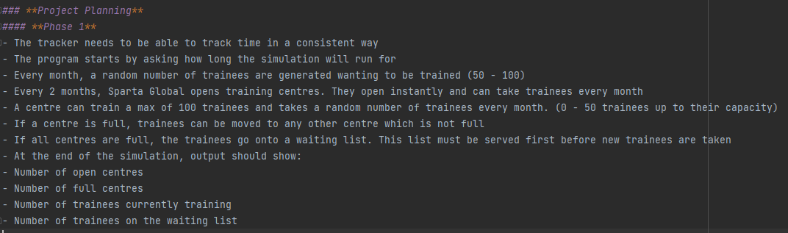
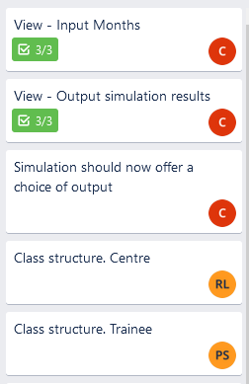
Structuring and Assigning tasks
Phase assignment is split into dividable chunks.
Using Trello, chunks are assigned to different people

Slide 4
Test-Driven Development (TDD)
In this project we used TDD to format our code structure.
Create tests first
Implement functionality.
We followed TDD in phase 1 and 2.
Since Phase 3 was getting a bit complicated, we decided to write the classes before testing them.

Slide 5
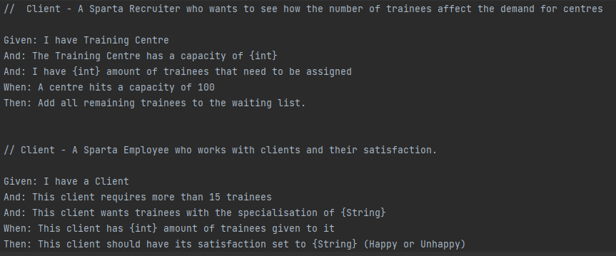
User Stories + Acceptance Criteria
User stories are important as it helps to place requirements in a more realistic format.
- Edge case testing is used here.
- By testing 14, 15 and 16 trainees we can ensure every outcome functions

Slide 6
Phase 1
Trainee/Controller/Controller tests – Piotr
Model tests – Aiden
Model/Output storage: File and Readme – Suyash, Hassan
Class structure/Centre class/Controller - Roberto
The View and Output – Conor

Slide 7
Phase 2
File output – Piotr
Model tests, Abstract Centre Class + Subclasses – Aiden
Model: Course types, Project random seeded generator, Trainee class development, tests and Readme- Suyash
Refactoring controller and main controller flow – Roberto
The View and Output – Conor
Controller, Course Type, Centre, Controller flow - Hassan

Slide 8
Phase 3
Integrated client into main and helped fix client issues - Roberto
Client – Piotr
Developing Presentation, JUnit testing - Aiden
JUnit testing, Manual testing, and Readme – Suyash
The View, Output and Emotional Support – Conor
Controller - Hassan

Slide 9
Before we submit
Additional Logging
Ensure acceptance criteria is met

Slide 10
Future Implementations
Doing more Error-handling. Try-Catch loops.
Adding more types to the simulation model (eg. more centre types, and more courses)
Adding some cashflow to the simulation (based on the data we will have for the trainees).

Slide 11
Thank you for Listening!
Any Questions?

